Slide 1
🌿 Welcome
Orland Park Area Chamber of Commerce Monthly Meeting May 28 | Sponsored by Lotus Healing & Wellness Center
Topic:
Mental Health Is Everyone’s Business
Understanding the vital role of mental well-being in our personal lives, workplaces, and communities.
Presented by: Emily Flores, LCPC Founder of Lotus Healing & Wellness Center Mental Health Therapist | Trauma-Informed | Community Advocate

Slide 2
1. Introduction
Welcome to the Orland Park Chamber of Commerce Monthly Meeting
Presented by Emily Flores, LCPC | Founder of Lotus Healing & Wellness Center
Hi, I'm Emily Flores, a Licensed Clinical Professional Counselor and the founder of Lotus Healing & Wellness Center in Orland Park. I specialize in trauma-informed and holistic mental health care for children, teens, and adults.
At Lotus Healing, we believe that mental health is not a luxury—it's a necessity. Our team provides individualized support for those navigating anxiety, depression, grief, and life transitions.
🧠 Why Mental Health Awareness Matters
1 in 5 adults in the U.S. experience mental illness each year
1 in 6 youth (ages 6–17) experience a mental health disorder annually
50% of all lifetime mental illnesses begin by age 14
The average delay between symptom onset and treatment is 11 years
Let’s work together to reduce stigma and promote well-being in our community.

Slide 3
🧠 What Is Mental Health?
Mental health includes our emotional, psychological, and social well-being. It affects how we think, feel, and act—and how we handle stress, relate to others, and make choices.
Mental health is important at every stage of life—from childhood through adulthood.
Why It Matters:
It’s just as important as physical health
Influences every stage of life, from childhood to adulthood
Affects our relationships, productivity, and overall quality of life
Mental Health ≠ Mental Illness
Everyone has mental health. Just like physical health, it can be nurtured, strengthened, or become unbalanced over time.
🌍 Why Mental Health Is Important for Everyone
Mental health impacts every part of life—regardless of age, background, or profession. It shapes how we:
Cope with stress and challenges
Build and maintain relationships
Perform at work and school
Make decisions and manage emotions

Slide 4
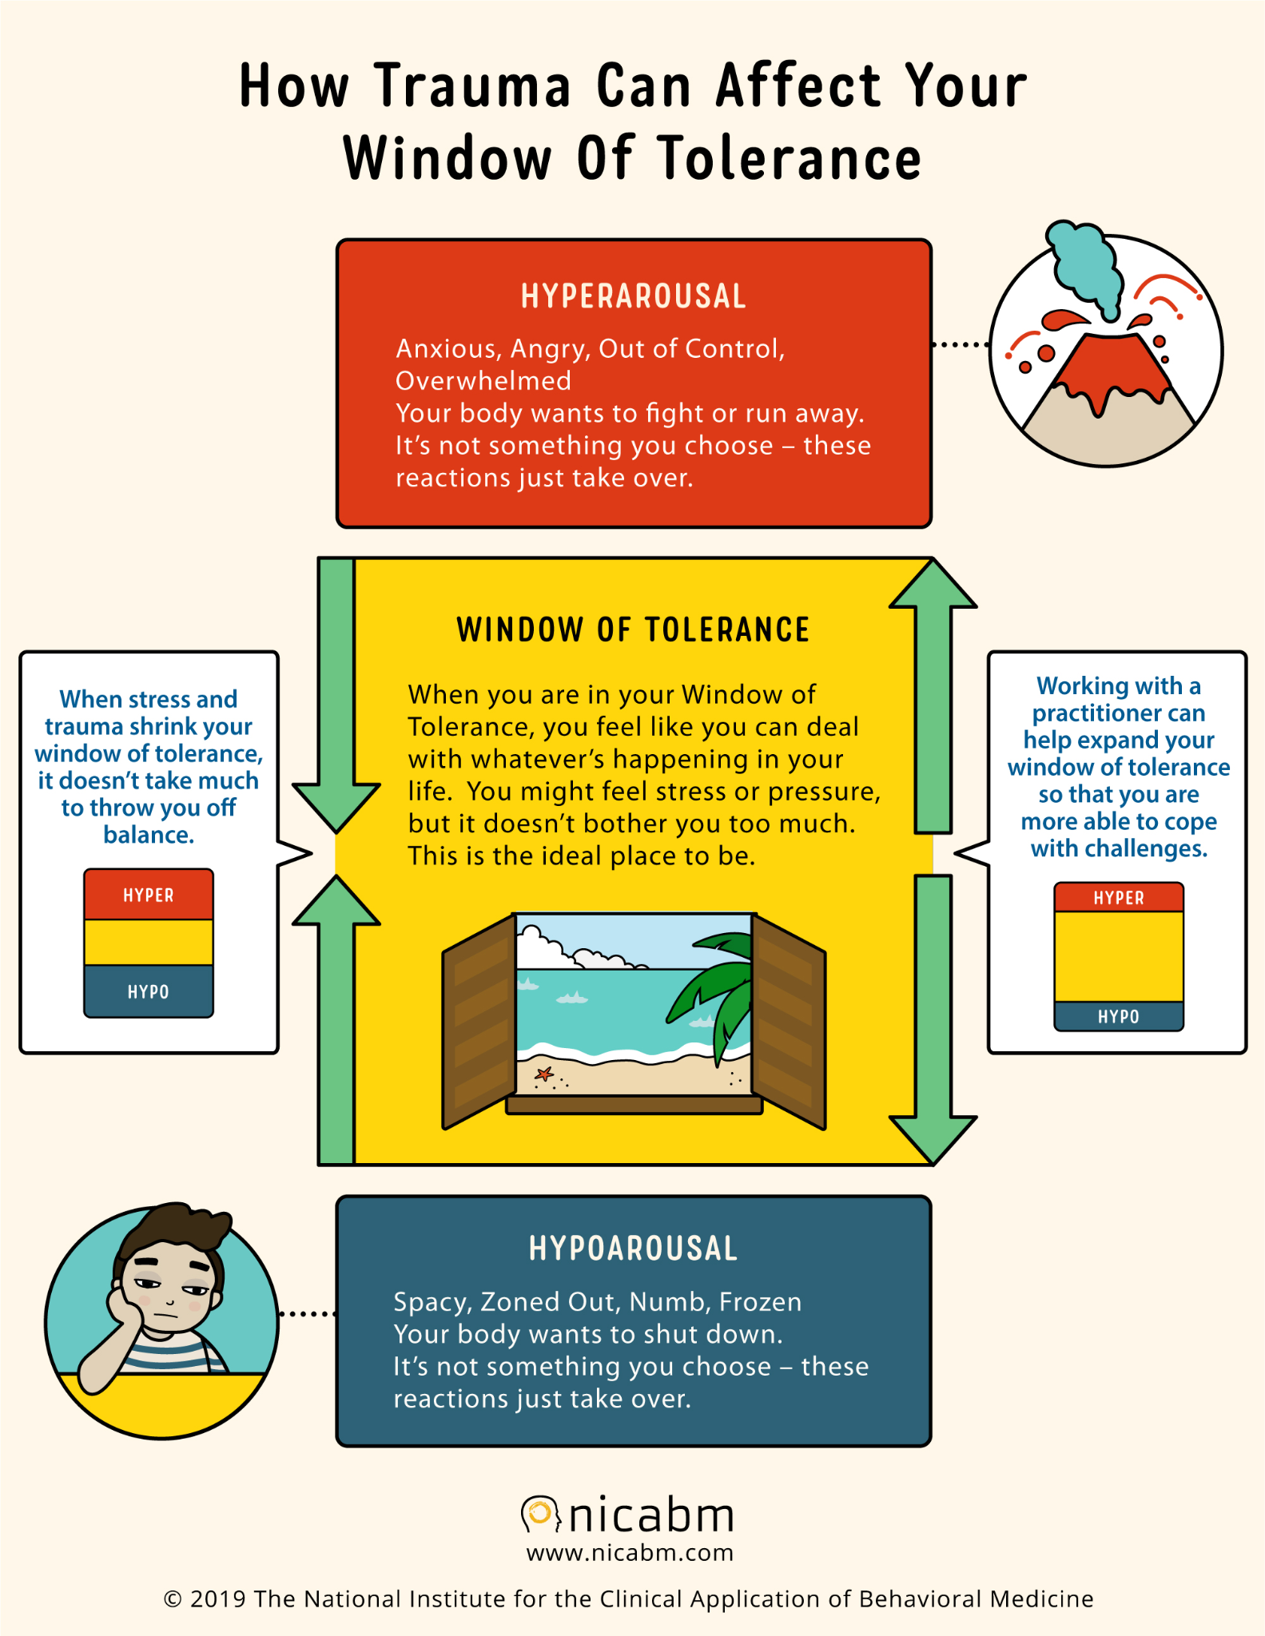
🪟 The Window of Tolerance
The Window of Tolerance represents the optimal zone where we function best — feeling calm, present, and able to cope with daily stress.
Inside the Window:
Regulated nervous system
Able to think clearly, connect, and respond intentionally
Outside the Window:
🟥 Hyperarousal (Fight/Flight) – Anxiety, panic, anger, racing thoughts
🟦 Hypoarousal (Freeze/Shutdown) – Numbness, disconnection, low energy, zoning out
Why It Matters:
Understanding your window helps build awareness of your emotional responses and develop tools to return to regulation.

Slide 5
🛠️ Practical Strategies to Support Your Mental Health
🧘‍♀️ 1. Regulate Your Nervous System
Deep breathing, grounding exercises, stretching
Practice mindfulness or meditation for 5–10 minutes daily
⏰ 2. Establish a Routine
Prioritize sleep, regular meals, and consistent schedules
Include time for rest and meaningful activities
🧍‍♂️🧍 3. Connect with Others
Talk to someone you trust
Seek out safe, supportive spaces — community, faith, or therapy
✍️ 4. Track & Name Your Emotions
Journaling, mood apps, or simply pausing to reflect
Identify emotional triggers and early warning signs
🚫 5. Set Boundaries
Say no without guilt
Limit exposure to stressors (including media and toxic relationships)
-

Slide 6
🤝 How to Support Yourself & Others in Mental Health
💚 Support Yourself:
Practice self-compassion – speak to yourself like you would a friend
Know your signs – notice when you're stressed, anxious, or withdrawing
Ask for help – therapy, support groups, and hotlines are acts of strength
Engage in small acts of wellness – movement, hydration, journaling, rest
🫂 Support Others:
Listen without judgment – create safe space, not solutions
Validate their experience – “That sounds really hard. I’m here.”
Encourage professional help – therapy, support groups, or EAP services
Check in regularly – a simple “How are you, really?” goes a long way
You don’t need to be a therapist to be a support. You just need to be present, patient, and kind.

Slide 7
🧭 Community Resources & Crisis Support
🪷 Lotus Healing & Wellness Center
Individual, couples, and family therapy
Trauma-informed, holistic care for ages 5+
Located in Orland Park 🌐 www.lotushealingandwellnesscenter.com 📞 312-912-2974
📚 LocaL
l Mental Health Resources
NAMI Chicago – Support groups & education www.namichicago.org | (833) 626-4244
Pillars Community Health – Sliding scale therapy www.pillarscommunityhealth.org | (708) 745-5277
211 – Free resource navigator for mental health, housing, food & more Dial 2-1-1 or visit www.211.org
🚨 Crisis Hotlines
Suicide & Crisis Lifeline: 📞 988 (call or text anytime, 24/7)
Crisis Text Line: Text HOME to 741741

