Slide 1
OPACC Monthly Membership Meeting
January 22, 2025

Slide 2
Mark Your Calendars!
1/23- Business After Hours & RC, Darvin Furniture’s Marketplace, 4-6 p.m.
1/24- New Member Orientation, Chamber Office, 9-10 a.m.
1/28- Young Pros, Dave & Buster’s, 5:30-7:30 p.m.
2/6- Installation & Award Ceremony, Porsche Orland Park, 6-10 p.m.
2/11- Ambassador Committee Meeting, Liberty Pointe, 8-9 a.m.
Next MMM 2/26 at 12 p.m.

Slide 3
Agenda
1. Importance of Being a Member: Public opinion poll about the impact and value.
2. Info Hub and Member Management System: Introducing our latest tools to our members.
3. Sponsorship Booklet: Explore new opportunities for sponsorship and engagement.
4. Promotional Opportunities: Learn about various ways you can promote your business through various avenues that are available through the Chamber.
5. Increasing Advocacy Resources: Discover how we're enhancing our advocacy efforts to better support you and provide up-to-date information.
6. Annual Community Guide: Overview of the upcoming annual guide and how you can be featured.

Slide 4
Overview of Findings (Association of Chamber of Commerce Executives)
Association of Chamber of Commerce Executives (ACCE), in partnership with The Harris Poll, studied U.S. adults’ perceptions of their local chamber of commerce, the role chambers play in their communities and the value of chamber membership to businesses. Here are some of the key findings:
TRUSTWORTHY: 81% of U.S. adults agree that their local chamber is a trusted resource and partner for businesses. 90% feel that their local chambers has an impact on growing the local economy.
CREDIBILITY: 64% of adults are more likely to purchase goods and services from a business that they know is a member of their local chamber.
COMMUNITY: 76% of U.S. adults agree that local chambers are stewards of a strong local economy. 74% believe local chambers create jobs and promote local community development. 72% believe local chambers play a key role in addressing community challenges.

Slide 5
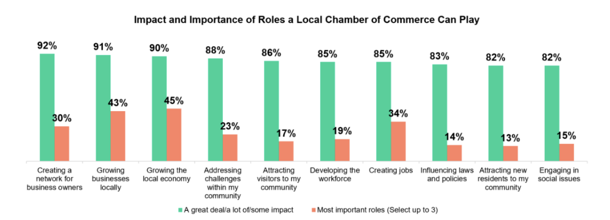
Overview of Findings (Association of Chamber of Commerce Executives)
More key findings:
SATISFACTION: 86% of U.S. adults are satisfied with their local chamber.
VISIBILITY: 74 % of U.S. adults stated that they believe that the local chamber helped to create jobs and promoted local community development.

Slide 6
Overview of Findings (Association of Chamber of Commerce Executives)
This survey was conducted between September 5-9, 2024 among 2,075 adults (18+), including 141 respondents who are business owners by The Harris Poll on behalf of the Association of Chamber of Commerce Executives (ACCE).
Data weighted where necessary, and the Respondents for this survey were selected from among those who agreed to participate.

Slide 7
GrowthZone & Info Hub
Why the switch?
More user friendly
Updated appearance
Additions to Committees/Lists
Better communication
Easy transactions
Autopay
Click the link to create an account and get started or log in to use the portal:
https://orlandparkareachamberofcommerce.growthzoneapp.com/MIC/Login

Slide 8
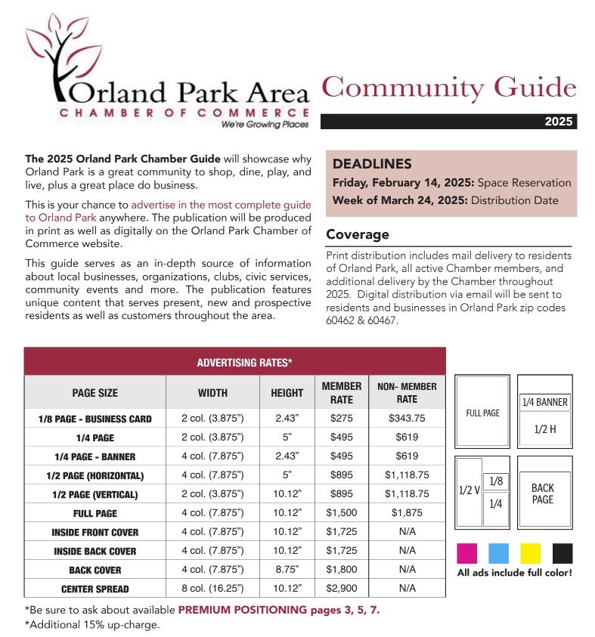
Community Guide
2024 Community Guide available at Chamber office
Digital guide: https://issuu.com/shawmedia/docs/orlandpark_2024?fr=sYzE0NTczNDgxNjA
OPACC is working with Shaw Media on production
Rep to contact members regarding advertisement opportunities OR contact Lora Healy to reserve spot today!
708.377.8413
Lhealy@shawmedia.com

Slide 9
Sponsorship & Promo Opportunities
A year planned ahead!
Digital copy is available on website: https://orlandparkchamber.org/db/OPACC_sponsorship_guide/index.html
A printed copy has been mailed to the membership
Why was it created?
1. Event organization
2. “If only we’d known sooner!”
Benefits v. additional promo opportunities available
Membership Guide- your key to understanding benefits. https://orlandparkchamber.org/db/OPACC_membership_guide/index.html
Add-On Services - Did you know that we offer additional services, some of which are free for certain membership tiers? We also strive to include everyone, ensuring that these services are accessible to all our members. Be to check them out! https://orlandparkchamber.org/add-ons/

Slide 10
Increase Advocacy
Plan on hosting legislative forum with the Small Business Advocacy Council (SBAC) and State Legislators in March- what is being discussed in Springfield?
Invited to a meeting with State Representative Mary Gill
Chamber Day March 19th
ReadyNation member- business leaders coming together to help strengthen the workforce and economic development through investments in kids and their education.

Slide 11
QUESTIONS???
This is just some of the new things coming in 2025…

